Slide 1
Chapter 8: Main Memory

Slide 2
Logical vs. Physical Address Space
The concept of a logical address space that is bound to a separate physical address space is central to proper memory management
  Logical address – generated by the CPU; also referred to as virtual address
  Physical address – address seen by the memory unit
Hardware device that maps virtual address to physical address is called memory-management unit (MMU)
In MMU scheme, the value in the relocation register (base register) is added to every address generated by a user process at the time it is sent to memory
The user program deals with logical addresses; it never sees the real physical addresses

Slide 3

Dynamic relocation using a relocation register

Slide 4
Contiguous Allocation
Main memory usually into two partitions:
  Resident operating system, usually held in low memory with interrupt vector
  User processes then held in high memory
  Each process is contained in a single contiguous section of memory
  Relocation-register scheme used to protect user processes from each other, and from changing operating-system code and data
  Relocation register contains value of smallest physical address; limit register contains range of logical addresses – each logical address must be less than the limit register

Slide 5
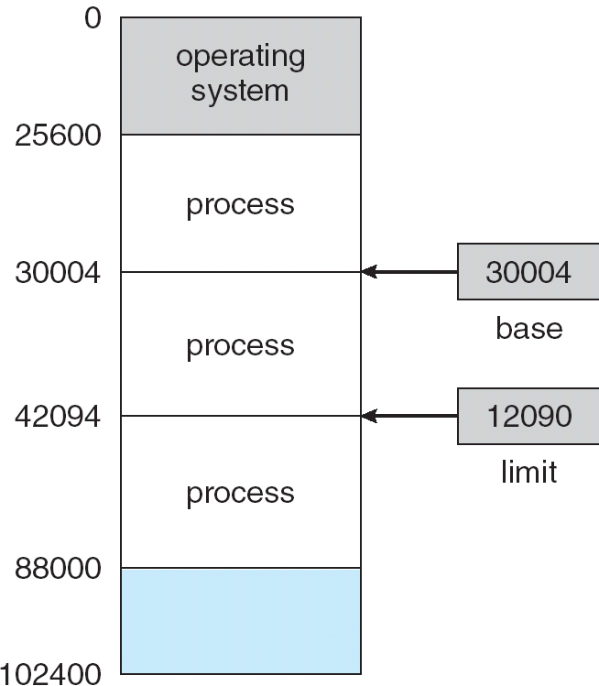
A base and a limit register define a logical address space

Slide 6
Contiguous Allocation (Cont.)
Multiple-partition allocation
  Hole – block of available memory; holes of various size are scattered throughout memory
  When a process arrives, it is allocated memory from a hole large enough to accommodate it
  Operating system maintains information about:
  a) allocated partitions b) free partitions (hole)
OS
OS
OS
OS
process 5
process 5
process 5
process 5
process 9
process 9
process 8
process 10
process 2
process 2
process 2
process 2

Slide 7
Dynamic Storage-Allocation Problem
How to satisfy a request of size n from a list of free holes
First-fit: Allocate the first hole that is big enough
Best-fit: Allocate the smallest hole that is big enough; must search entire list, unless ordered by size. Produces the smallest leftover hole.
Worst-fit: Allocate the largest hole; must also search entire list. Produces the largest leftover hole.
First-fit and best-fit better than worst-fit in terms of speed and storage utilization
External Fragmentation – total memory space exists to satisfy a request, but it is not contiguous
Internal Fragmentation – allocated memory may be slightly larger than requested memory; this size difference is memory internal to a partition, but not being used

Slide 8

Paging
Paging is a memory-management scheme that permits the physical address space of a process to be noncontiguous.
Divide physical memory into fixed-sized blocks called frames (size is power of 2, between 512 bytes and 8192 bytes).
Divide logical memory into blocks of same size called pages.
Keep track of all free frames.
To run a program of size n pages, need to find n free frames and load program.
Set up a page table to translate logical to physical addresses.
Internal fragmentations still exist, but limited by the frame size.

Slide 9

Paging and Frame Allocation
Before allocation
After allocation

Slide 10

Address Translation Scheme
Virtual address generated by CPU is divided into:
  Page number (p) – used as an index into a page table which contains base address of each page in physical memory.
  Page offset (d) – combined with base address to define the physical memory address that is sent to the memory unit.

Slide 11
Implementation of Page Table
Page table is kept in main memory
Page-table base register (PTBR) points to the page table
Page-table length register (PRLR) indicates size of the page table
In this scheme every data/instruction access requires two memory accesses. One for the page table and one for the data/instruction.
The two memory access problem can be solved by the use of a special fast-lookup hardware cache called associative memory or translation look-aside buffers (TLBs)

Slide 12

Paging Hardware With TLB

Slide 13
Segmentation
Users prefer to view memory as a collection of variable-sized segments without necessary ordering among segments
A program is a collection of segments. A segment is a logical unit such as:
main program,
procedure,
function,
method,
object,
local variables, global variables,
common block,
stack,
symbol table, arrays
Memory-management scheme that supports user view of memory

Slide 14

User’s View of a Program
A logical-address is a collection of segments, each segment has a name and a length

Slide 15
Segmentation Architecture
Logical address consists of a two tuple:
<segment-number, offset>
Segment table – maps logical address to physical addresses; each table entry has:
  base – contains the starting physical address where the segments reside in memory.
  limit – specifies the length of the segment.
Segment-table base register (STBR) points to the segment table’s location in memory.
Segment-table length register (STLR) indicates number of segments used by a program;
1
1
4
2
3
4
2
3
user space
physical memory space

Slide 16

Example of Segmentation

Slide 17
Example of Segmentation

Slide 18

Address Translation Architecture

Slide 19
End of Chapter 8

